Slide 1

Accidental Click Analysis:
Product Insights
Data-driven exploration of user click behaviour, revenue impact, and actionable recommendations.
Created by Simona Levitsky

Slide 2

The Challenge
Distinguishing Intent from Accident
Company T displays ads on content websites where users engage with articles and media. While many clicks represent genuine purchase interest, others occur accidentally—users trying to close pop-ups, scroll through content, or navigate away inadvertently trigger ad clicks.
These accidental clicks redirect users to advertiser sites against their will, degrading user experience and potentially wasting advertiser budgets on low-intent traffic.

Slide 3
The Core Hypothesis
Clicks occurring immediately after ad visibility are more likely to be accidental. Genuine users won't mind clicking twice if their first attempt is blocked.
01
02
Ad Becomes Visible
Click Occurs
User scrolls to content, ad enters viewport
Time measured from visibility to click event
03
04
First Click Blocked
User Response
System intercepts click, keeps user on page
Intentional users click again; accidental users continue browsing
This insight led to the creation of a key metric: % 2nd Clicks = (Number of 2nd clicks after blocking) / (Number of 1st clicks blocked). This ratio reveals user intent and helps optimize blocking thresholds.

Slide 4



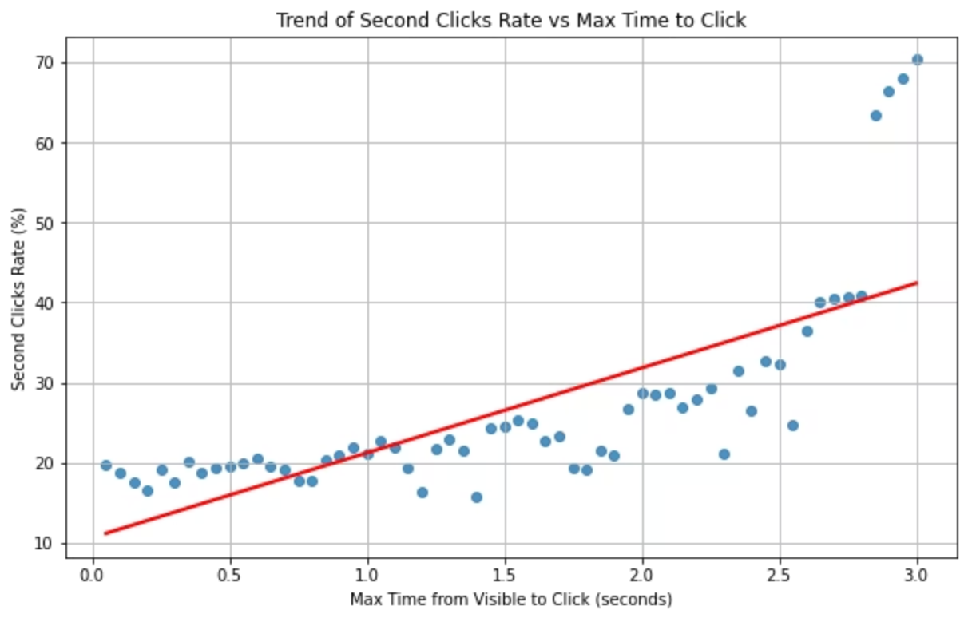
Does Time Predict Intent?
Immediate Clicks
Delayed Clicks
Strong Correlation
0–0.5 seconds: Only 19% of users click again after blocking, strongly suggesting accidental behavior driven by interface mishaps.
2.5+ seconds: Approximately 45% re-click rate indicates genuine purchase interest and deliberate user engagement.
Positive relationship between time-to-click and second-click rate validates the hypothesis across all platforms.

Slide 5

Platform-Specific Behavior Patterns
Mobile & Tablet
Desktop
37-41% overall 2nd click rate
~55% overall 2nd click rate
Touch interfaces create higher accident rates. Fat-finger errors and scroll-triggered taps lead to more unintentional clicks requiring aggressive filtering.
Precise mouse control reduces accidents. Users demonstrate stronger intent signals, with some high time-to-click outliers warranting further investigation.
Tablet Trend Strength
Correlation between time and intent is strongest on tablets, suggesting distinct behavioral patterns worth leveraging in threshold design.

Slide 6
Selecting Optimal Thresholds
Two strategic approaches balance user experience improvement against revenue protection:
Conservative: <0.5 Seconds
Aggressive: <2 Seconds
Revenue loss: $3,316 (8.6% of total)
Revenue loss: $17,355 (45.1% of total)
Targets only ultra-fast, highly suspicious clicks
Dramatically reduces accidental clicks
Minimal revenue risk with measurable UX improvement
Filters substantial genuine intent, higher revenue impact
Ideal for traffic volume-focused accounts
Best for conversion-rate-focused advertisers

Slide 7




Strategic Revenue Recovery Insight
Block Fast Clicks
Intercept suspicious clicks based on time threshold
Genuine Users Re-Click
Intentional users demonstrate persistence, recovering 60%+ revenue at 2s+ delays
Preserve Revenue
Revenue recovery ratio increases with longer time delays, validating tiered approach
The revenue-per-click analysis reveals that accidental clicks (<1s) aren't significantly less valuable than intentional ones (~$0.09 vs $0.10). This means time alone isn't a perfect signal for low-value traffic, but the second-click behavior provides the critical differentiation.

Slide 8
Product Innovation Opportunity
Dual Product Offering Strategy
This segmentation mirrors industry standards like viewable vs. standard impressions, giving company T competitive advantages:
"High-Intent Clicks" Premium
Strict 2-second threshold
Pricing flexibility across advertiser tiers
Guaranteed high-conversion traffic
Better advertiser matching to campaign goals
Higher CPC pricing justified
Transparency and control as differentiators
Lower bounce rates, efficient acquisition
Platform-specific optimization opportunities
"Standard Clicks" Volume
Minimal 0.5-second filtering
Maximum reach and impressions
Lower CPC, accessibility-focused
Ideal for brand awareness campaigns

Slide 9
Additional Testing Hypotheses
Generated through AI-assisted analysis to identify new accidental click detection opportunities:
Mobile/tablet show lower second-click rates, indicating more accidental clicks
Blocking <1s clicks reduces revenue almost as much as intentional clicks
Longer click delays recover more revenue from intentional users

Slide 10
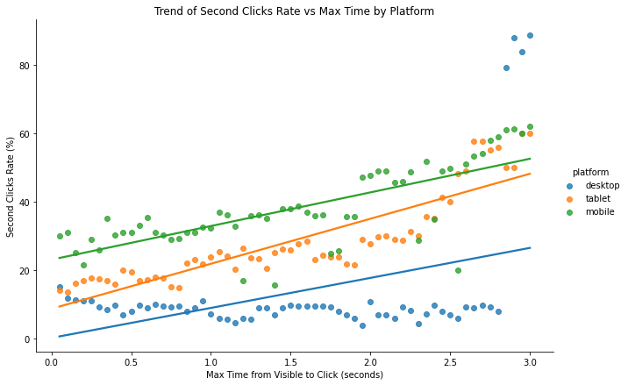
Trend Line by Platform
Trend Line by Platform

Slide 11
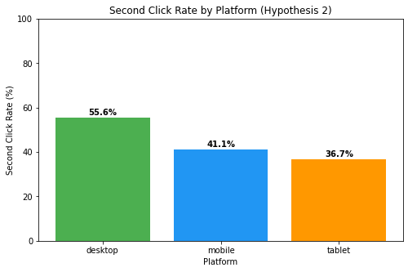
Aggregate second clicks rate by platform
Mobile and tablet show lower overall % 2nd Clicks (around 37-41%), indicating higher rates of accidental clicks where users are less likely to re-click after a block. Desktop have a higher % (around 55%), suggesting fewer accidents and more persistence from intentional users. This could justify platform-specific blocking thresholds, such as more aggressive blocking on mobile/tablet to improve user experience while preserving revenue on desktop.

Slide 12
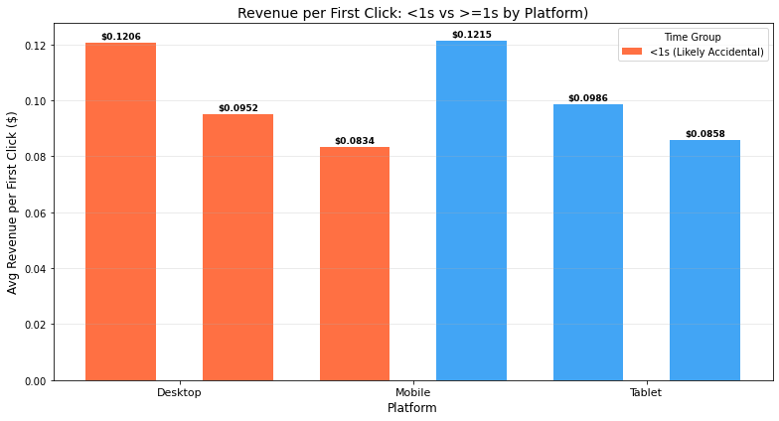
Revenue per First Click + % Difference
Accidental clicks (<1s) are not much less valuable in terms of revenue per click. Blocking <1s clicks will cost revenue almost as much as blocking intentional ones. Time alone is not a strong signal for low-value clicks.

Slide 13
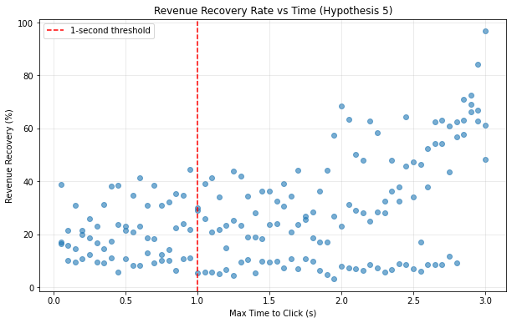
Hypothesis : The ratio of second-click revenue to blocked first-click revenue increases with time
showing higher "recovery" of intentional revenue at longer delays. Why? Intentional users re-click and generate nearly full revenue; accidental ones don’t.
Positive correlation (~0.47), with recovery >60% above 2s, justifying time-tiered blocking.

Slide 14
Key Recommendations
Implement Conservative Threshold Initially
Develop Tiered Product Offerings
Continue Platform-Specific Optimization
Create "Premium" and "Standard" click products with different threshold levels, allowing advertisers to choose based on their conversion vs. volume priorities.
Start with <0.5s blocking to improve UX with minimal revenue risk. Monitor 2nd click rates and platform-specific behavior closely during rollout.
Given the 37-41% mobile/tablet rate vs. 55% desktop rate, design platform-aware blocking logic to maximize effectiveness across device types.
This analysis demonstrates that strategic click filtering can simultaneously improve user experience and protect revenue through data-driven threshold selection and product differentiation.

